Slide 1
Gen AI Orchestrator for Email and Document Triage/Routing
TEAM: AI SQUADS

Slide 2
Team Members
Suresh Padala
Ranjana Arjariya
Garima Raha
Gangashekar Adumulla

Slide 3
Challenge Description
This AI-powered tool automates the triage and routing of emails and
documents in financial systems.
Extracts key financial data from unstructured content
Classifies requests by type and urgency
Detects and flags duplicate or redundant information
Utilizes Mistral-7B for advanced text understanding and classification
Helps streamline operations by integrating into existing document workflows

Slide 4
Solution Approach
Our solution leverages Generative AI to automate the extraction, classification, and routing of financial documents and emails.
The approach is designed to handle unstructured content across multiple formats and convert it into structured, actionable insights, as per below steps:
1. Multi-Format Document Ingestion
2. Text Extraction & Preprocessing
3. Generative AI for Data Extraction
4. Request Type Classification
5. Structured Output Generation

Slide 5
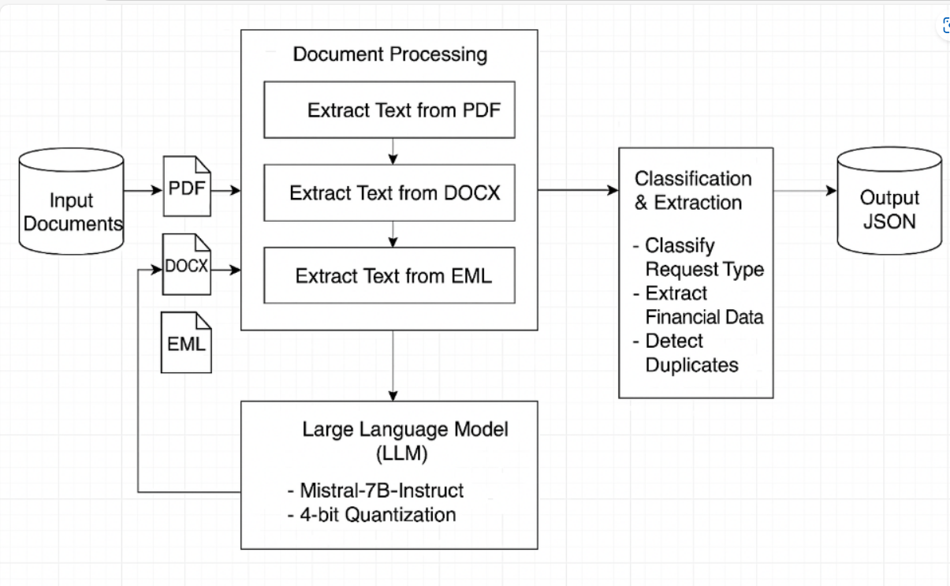
Design Architecture

Slide 6
Sample Input & Output
Sample Input: PDF with fields like: Bank Name: ABC Bank Adjustment Amount: ₹1,20,000
Sample Output (JSON): json
{
"Request Type": "Adjustment",
"Sub Request Type": "—",
"Confidence Score": 1.0
}

Slide 7
How to Run
Place samples files into Input/ folder
Run: python script: main.py
JSON output saved in Output/ folder
Log file: processing.log

Slide 8
Tech stack
Mistral-7B Instruct Model (Optimized with 4-bit Quantization)
Programming Language- Python 3.9+
Python Libraries:
PyTorch
Transformers (Hugging Face)
Document parsing libraries
BitsAndBytes

Slide 9
Thank You
Q&A: for more details or to explore the project,
Visit: 🔗 GitHub: https://github.com/ewfx/gaied-ai-squad/tree/main

